Slide 1
Instruction Queue
➢ 8086 employs parallel processing
➢ When EU is busy decoding or executing current instruction, the buses of 8086 may not be in use.
➢ At that time, BIU can use buses to fetch upto six instruction bytes for the following instructions
➢ BIU stores these pre-fetched bytes in a FIFO register called Instruction Queue
➢ When EU is ready for its next instruction, it simply reads the instruction from the queue in BIU
1

Slide 2
Pipelining
➢EU of 8086 does not have to wait in between for BIU to fetch next instruction byte from memory
➢So the presence of a queue in 8086 speeds up the processing
➢Fetching the next instruction while the current instruction executes is called pipelining
2

Slide 3
Memory Segmentation
➢ 8086 has a 20-bit address bus
➢ So it can address a maximum of 1MB of memory
➢ 8086 can work with only four 64KB segments at a time within this 1MB range
➢ These four memory segments are called
• Code segment
• Stack segment
• Data segment
• Extra segment
3

Slide 4
Memory
64KB Memory Segment
1
2
3
4
5
6
7
8
9
10
11
12
13
14
15
16
00000H
4
Only 4 such segments can be addressed at a time
5
6
7
1MB
Address Range
FFFFFH
4

Slide 5
Code Segment
➢ That part of memory from where BIU is currently fetching instruction code bytes
Stack Segment
➢ A section of memory set aside to store addresses and data while a subprogram executes
Data & Extra Segments
➢ Used for storing data values to be used in the program
5

Slide 6
Memory
Code Segment
1
2
3
4
5
6
7
8
9
10
11
12
13
14
15
16
00000H
Data & Extra Segments
1MB
Address Range
Stack Segment
FFFFFH
6

Slide 7
Segment Registers
➢hold the upper 16-bits of the starting address for each of the segments
➢The four segment registers are
• CS (Code Segment register)
• DS (Data Segment register)
• SS (Stack Segment register)
• ES (Extra Segment register)
7

Slide 8
Memory
1
Code Segment
3
4
Data Segment
Extra Segment
7
8
9
10
11
12
13
14
15
Stack Segment
00000H
CS
1000
0H
DS ES
0H
0H
4000
5000
Starting Addresses
of Segments
1MB
Address Range
SS
F000
0H
FFFFFH
8

Slide 9
➢Address of a segment is of 20-bits
➢A segment register stores only upper 16- bits
➢BIU always inserts zeros for the lowest 4- bits of the 20-bit starting address.
➢E.g. if CS = 348AH, then the code segment will start at 348A0H
➢A 64-KB segment can be located anywhere in the memory, but will start at an address with zeros in the lowest 4-bits
9

Slide 10
Instruction Pointer (IP) Register
➢a 16-bit register
➢Holds 16-bit offset, of the next instruction byte in the code segment
➢BIU uses IP and CS registers to generate the 20-bit address of the instruction to be fetched from memory
10

Slide 11
Physical Address Calculation
Memory
Start of Code Segment
1
Data Segment
3
4
Code Segment
Extra Segment
7
8
9
10
11
12
13
14
15
Stack Segment
00000H
348A0H
IP = 4214H
MOV AL, BL
Code Byte
38AB4H
1MB
Address Range
CS
IP
Physical Address
348A0 H
+ 4214 H
38AB4 H
FFFFF⁷²H

Slide 12
Stack Segment (SS) Register Stack Pointer (SP) Register
➢Upper 16-bits of the starting address of stack segment is stored in SS register
➢It is located in BIU
➢SP register holds a 16-bit offset from the start of stack segment to the top of the stack
➢It is located in EU
12

Slide 13
Other Pointer & Index Registers
➢Base Pointer (BP) register
➢Source Index (SI) register
➢Destination Index (DI) register
➢Can be used for temporary storage of data
➢Main use is to hold a 16-bit offset of a data word in one of the segments
13

Slide 14
ADDRESSING MODES OF 8086
14

Slide 15
Various Addressing Modes
1. Immediate Addressing Mode
2. Register Addressing Mode
3. Direct Addressing Mode
4. Register Indirect Addressing Mode
5. Index Addressing Mode
6. Based Addressing Mode
7. Based & Indexed Addressing Mode
8. Based & Indexed with displacement Addressing Mode
9. Strings Addressing Mode
Presented by C.GOKUL,AP/EEE , Velalar College of Engg & Tech, Erode
76

Slide 16
1. IMMEDIATE ADDRESSING MODE
• The instruction will specify the name of the register which holds the data to be operated by the instruction.
• Source data is within the instruction
• Ex: MOV AX,10ABH
➔ AL=ABH,
AH=10H
16

Slide 17
2.REGISTER ADDRESSING MODE
• In immediate addressing mode, an 8-bit or 16-bit data is specified as part of the instruction
• Ex: MOV AX,BLH MOV AX,BLH
17

Slide 18
3. DIRECT ADDRESSING MODE
• Memory address is supplied with in the instruction
• Mnemonic: MOV AH,[MEMBDS] AH [1000H]
• But the memory address is not
index or pointer register
18

Slide 19
4. REGISTER INDIRECT ADDRESSING MODE
• Memory address is supplied in an index or pointer register
• EX:
MOV AX,[SI] ;
JMP [DI] ;
AL [SI] ; AH [SI+1] IP [DI+1: DI]
INC BYTE PTR [BP] ; [BP] DEC WORD PTR [BX] ;
[BX+1:BX]
[BP]+1
[BX+1:BX]-1
19

Slide 20
5.Indexed Addressing Mode
• Memory address is the sum of index register plus displacement
MOV AX,[SI+2] AL [SI+2]; AH [SI+3] JMP [DI+2] IP [BX+3:BX+2]
20

Slide 21
6. Based Addressing Mode
• Memory address is the sum of the BX or BP base register plus a displacement within instruction
• Ex:
MOV AX,[BP+2] AL [BP+2]; AH [BP+3] JMP [BX+2] IP [BX+3:BX+2]
21

Slide 22
7.BASED & INDEX ADDRESSING MODES
• Memory address is the sum of the index register & base register
Ex:
MOV AX,[BX+SI] ; AL [BX+SI] ; AH JMP [BX+DI] ; IP
[BX+SI+1]
[BX+DI+1 : BX+DI]
INC BYTE PTR [BP+SI] ; [BP]
[BP]+1
DEC WORD PTR [BP+DI] ;
[BX+1:BX]
[BX+1:BX]-1
22

Slide 23
8. BASED & INDEXED WITH DISPLACEMENT ADDRESSING MODE
• Memory address is the sum of an index register , base register and displacement within instruction
MOV AX,[BX+SI+6] ; AL [BX+SI+6] ; AH
JMP [BX+DI+6] ; IP
[BX+SI+7]
[BX+DI+7 : BX+DI+6]
INC BYTE PTR [BP+SI+5] ; DEC WORD PTR [BP+DI+5] ;
Presented by C.GOKUL,AP/EEE , Velalar College of Engg & Tech, Erode
23

Slide 24
9. Strings Addressing Mode
• The memory source address is a register SI in the data segment, and the memory destination address is register DI in the extra segment
• Ex: MOVSB [ES:DI] [DS:SI]
• If DF=0 SI
DF=1 SI
SI+1 SI-1
, DI DI+1
, DI DI-1
24

Slide 25
INSTRUCTION SET of 8086
25

Slide 26

Instruction set basics
• Instruction:- An instruction is a binary pattern designed inside a microprocessor to perform a specific function.
• Opcode:- It stands for operational code. It specifies the type of operation to be performed by CPU. It is the first field in the machine language instruction format.
• E.g. 08 is the opcode for instruction “MOV X,Y”.
• Operand:- We can also say it as data on which operation should act. operands may be register values or memory values. The CPU executes the instructions using information present in this field. It may be 8-bit data or 16-bit data.
26

Slide 27

Instruction set basics
• Assembler:- it converts the instruction into sequence of binary bits, so that this bits can be read by the processor.
• Mnemonics:- these are the symbolic codes for either instructions or commands to perform a particular function.
• E.g. MOV, ADD, SUB etc.
27

Slide 28



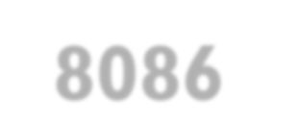

Types of instruction set of 8086 microprocessor
(1). Data Copy/Transfer instructions.
(2). Arithmetic & Logical instructions.
(3). Branch instructions.
(4). Loop instructions.
(5). Machine Control instructions. (6). Flag Manipulation instructions. (7). Shift & Rotate instructions. (8). String instructions.
28

Slide 29



(1). Data copy/transfer instructions.
(1). MOV Destination, Source
⚫ There will be transfer of data from source to destination.
⚫ Source can be register, memory location or immediate data.
⚫ Destination can be register or memory operand.
⚫ Both Source and Destination cannot be memory location or segment registers at the same time.
⚫ E.g.
⚫ (1). MOV CX, 037A H;
⚫ (2). MOV AL, BL;
⚫ (3). MOV BX, [0301 H];
29

Slide 30
BEFORE EXECUTION
AFTER EXECUTION
AX | 2000H
MOV BX,AX
BX | 2000H
BEFORE EXECUTION
AFTER EXECUTION
A H |  | AL
B H |  | BL
C H |  | CL
D H |  | DL
40
A H |  | AL
B H |  | BL
C H |  | CL | 40
D H |  | DL
40
MOV CL,M
30

Slide 31
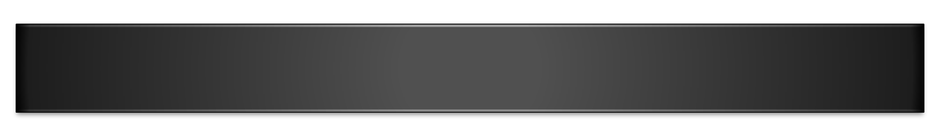

Stack Pointer
⚫ It is a 16-bit register, contains the address of the data item currently on top of the stack.
⚫ Stack operation includes pushing (providing) data on to the stack and popping (taking)data from the stack.
⚫ Pushing operation decrements stack pointer and Popping operation increments stack pointer. i.e. there is a last in first out (LIFO) operation.
31

Slide 32




(2). Push Source
⚫ Source can be register, segment register or memory.
⚫ This instruction pushes the contents of specified source on to the stack.
⚫ In this stack pointer is decremented by 2.
⚫ The higher byte data is pushed first (SP-1).
⚫ Then lower byte data is pushed (SP-2).
⚫ E.g.:
⚫ (1). PUSH AX;
⚫ (2). PUSH DS;
⚫ (3). PUSH [5000H];
32

Slide 33
INITIAL POSITION
(1) STACK POINTER
DECREMENTS SP & STORES HIGHER BYTE
HIGHER BYTE
(2) STACK POINTER
DECREMENTS SP & STORES LOWER BYTE
LOWER BYTE
HIGHER BYTE
(3) STACK POINTER
33

Slide 34
BEFORE EXECUTION
SP | 2002H
BH |  | BL
CH | 10 | CL | 50
DH |  | DL
2000H
2001H
2002H
PUSH CX
AFTER EXECUTION
2000H
2001H
2002H
50
10
SP | 2000H
BH |  | BL
CH | 10 | CL | 50
DH |  | DL
34

Slide 35

(3) POP Destination
⚫ Destination can be register, segment register or memory.
⚫ This instruction pops (takes) the contents of specified destination.
⚫ In this stack pointer is incremented by 2.
⚫ The lower byte data is popped first (SP+1).
⚫ Then higher byte data is popped (SP+2).
⚫ E.g.
⚫ (1). POP AX;
⚫ (2). POP DS;
⚫ (3). POP [5000H];
35

Slide 36
(1) STACK POINTER
INITIAL POSITION AND READS LOWER BYTE
LOWER BYTE
INCREMENTS SP & READS HIGHER BYTE
LOWER BYTE
HIGHER BYTE
(2) STACK POINTER
INCREMENTS SP
LOWER BYTE
HIGHER BYTE
(3) STACK POINTER
36

Slide 37
BEFORE EXECUTION
2000H
2001H
30
50
SP | 2000H
BH |  | BL
POP BX
2002H
AFTER EXECUTION
2000H
2001H
2002H
30
50
SP | 2002H
BH | 5 0 | BL | 30
37

Slide 38



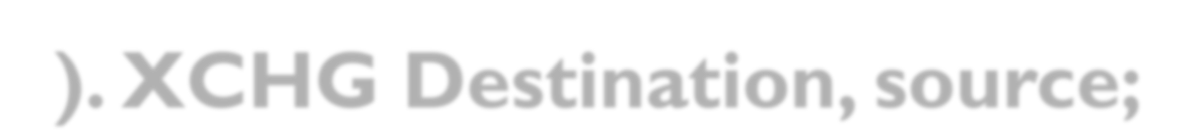
(4). XCHG Destination, source;
• This instruction exchanges contents of Source with destination.
• It cannot exchange two memory locations directly.
•The contents of AL are exchanged with BL.
•The contents of AH are exchanged with BH.
•E.g.
(1). XCHG BX, AX;
(2). XCHG [5000H],AX;
38

Slide 39
AFTER EXECUTION
BEFORE EXECUTION
AH | 20 | AL | 40
BH | 70 | BL | 80
AH | 70 | AL | 80
BH | 20 | BL | 40
XCHG AX,BX
39

Slide 40








(5)IN AL/AX, 8-bit/16-bit port address
⚫ It reads from the specified port address.
⚫ It copies data to accumulator from a port with 8- bit or 16-bit address.
⚫ DX is the only register is allowed to carry port address.
⚫ E.g.
(1). IN AL, 80H;
(2). IN AX,DX; //DX contains address of 16-bit port.
40

Slide 41
BEFORE EXECUTION
PORT 80H
10
AL
IN AL,80H
AFTER EXECUTION
10
AL | 10
PORT 80H
41

Slide 42



OUT 8-bit/16-bit port address, AL/AX
⚫ It writes to the specified port address.
⚫ It copies contents of accumulator to the port with 8-bit or 16-bit address.
⚫ DX is the only register is allowed to carry port address.
⚫ E.g.
(1). OUT 80H,AL;
(2). OUT DX,AX; //DX contains address of 16-bit port.
42

Slide 43
BEFORE EXECUTION
PORT 50H
10
AL | 40
OUT 50H,AL
AFTER EXECUTION
PORT 50H
40
AL | 40
43

Slide 44



(7) XLAT
⚫ Also known as translate instruction.
⚫ It is used to find out codes in case of code conversion.
⚫ i.e. it translates code of the key pressed to the corresponding 7-segment code.
⚫ After execution this instruction contents of AL register always gets replaced.
⚫ E.g. XLAT;
44

Slide 45




8.LEA 16-bit register (source), address (dest.)
⚫ LEA Also known as Load Effective Address (LEA).
⚫ It loads effective address formed by the destination into the source register.
⚫ E.g.
(1). LEA BX,Address;
(2). LEA SI,Address[BX];
45

Slide 46

(9). LDS 16-bit register (source), address (dest.); (10). LES 16-bit register (source), address (dest.);
⚫ LDS Also known as Load Data Segment (LDS).
⚫ LES Also known as Load Extra Segment (LES).
⚫ It loads the contents of DS (Data Segment) or ES (Extra Segment) & contents of the destination to the contents of source register.
⚫ E.g.
(1). LDS BX,5000H;
(2). LES BX,5000H;
46

Slide 47



(1). LDS BX,5000H;
(2). LES BX,5000H;
15
0
7 0
BX
20 | 10
10
5000H
20
5001H
5002H
DS/ES
40 | 30
30
40
5003H
47

Slide 48
(11). LAHF:- This instruction loads the AH register from the contents of lower byte of the flag register.
⚫ This command is used to observe the status of the all conditional flags of flag register.
E.g. LAHF;
(12). SAHF:- This instruction sets or resets all conditional flags of flag register with respect to the corresponding bit positions.
⚫ If bit position in AH is 1 then related flag is set otherwise flag will be reset.
E.g. SAHF;
48

Slide 49


PUSH & POP
(13). PUSH F:- This instruction decrements the stack pointer by 2.
⚫ It copies contents of flag register to the memory location pointed by stack pointer.
⚫ E.g. PUSH F;
(14). POP F:- This instruction increments the stack pointer by 2.
⚫ It copies contents of memory location pointed by stack pointer to the flag register.
⚫ E.g. POP F;
49

Slide 50


(2). Arithmetic Instructions
⚫ These instructions perform the operations like:
⚫ Addition,
⚫ Subtraction,
⚫ Increment,
⚫ Decrement.
50

Slide 51




(2). Arithmetic Instructions
(1). ADD destination, source;
⚫ This instruction adds the contents of source operand with the contents of destination operand.
⚫ The source may be immediate data, memory location or register.
⚫ The destination may be memory location or register.
⚫ The result is stored in destination operand.
⚫ AX is the default destination register.
⚫ E.g. (1). ADD AX,2020H;
(2). ADD AX,BX;
51

Slide 52

AFTER EXECUTION
BEFORE EXECUTION
AH | 30 | AL | 30
AH | 10 | AL | 10
ADD AX,2020H
1010
+2020
3030
AFTER EXECUTION
BEFORE EXECUTION
AH | 10 | AL | 10
BH | 20 | BL | 20
AH | 30 | AL | 30
BH | 20 | BL | 20
ADD AX,BX
52

Slide 53


ADC destination, source
⚫ This instruction adds the contents of source operand with the contents of destination operand with carry flag bit.
⚫ The source may be immediate data, memory location or register.
⚫ The destination may be memory location or register.
⚫ The result is stored in destination operand.
⚫ AX is the default destination register.
⚫ E.g. (1). ADC AX,2020H;
(2). ADC AX,BX;
53

Slide 54



(3) INC source
⚫ This instruction increases the contents of source operand by 1.
⚫ The source may be memory location or register.
⚫ The source can not be immediate data.
⚫ The result is stored in the same place.
⚫ E.g. (1). INC AX;
(2). INC [5000H];
54

Slide 55
BEFORE EXECUTION
AFTER EXECUTION
AH | 10 | AL | 11
INC AX
AH | 10 | AL | 12
BEFORE EXECUTION
AFTER EXECUTION
1011
INC [5000H]
5000H
1012
5000H
55

Slide 56


4. DEC source
⚫ This instruction decreases the contents of source operand by 1.
⚫ The source may be memory location or register.
⚫ The source can not be immediate data.
⚫ The result is stored in the same place.
⚫ E.g. (1). DEC AX;
(2). DEC [5000H];
56

Slide 57
DEC AX
BEFORE EXECUTION
AFTER EXECUTION
AH | 10 | AL | 11
AH | 10 | AL | 10
BEFORE EXECUTION
AFTER EXECUTION
1051
DEC [5000H]
5000H
1050
5000H
57

Slide 58

(5) SUB destination, source;
⚫ This instruction subtracts the contents of source operand from contents of destination.
⚫ The source may be immediate data, memory location or register.
⚫ The destination may be memory location or register.
⚫ The result is stored in the destination place.
⚫ E.g. (1). SUB AX,1000H;
(2). SUB AX,BX;
58

Slide 59
BEFORE EXECUTION
AFTER EXECUTION
AH | 20 | AL | 00
SUB AX,1000H
2000
-1000
=1000
AH | 10 | AL | 00
BEFORE EXECUTION
AFTER EXECUTION
AH | 20 | AL | 00
BH | 10 | BL | 00
AH | 10 | AL | 00
BH | 10 | BL | 00
SUB AX,BX
59

Slide 60

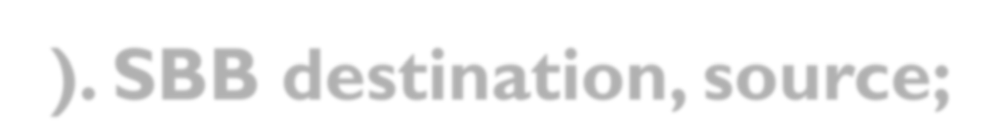
(6). SBB destination, source;
⚫ Also known as Subtract with Borrow.
⚫ This instruction subtracts the contents of source operand & borrow from contents of destination operand.
⚫ The source may be immediate data, memory location or register.
⚫ The destination may be memory location or register.
⚫ The result is stored in the destination place.
⚫ E.g. (1). SBB AX,1000H;
(2). SBB AX,BX;
60

Slide 61
BEFORE EXECUTION AFTER EXECUTION
B | 1
AH |  | 20 |  | AL | 20
SBB AX,1000H
AH | 10 | AL | 19
2020
- 1000
1020-
1=1019
BEFORE EXECUTION
AFTER EXECUTION
B | 1
AH |  | 20 |  | AL | 20
BH |  | 10 |  | BL | 10
AH | 10 | AL | 19
BH | 10 | BL | 10
SBB AX,BX
2050
61

Slide 62

(7). CMP destination, source
⚫ Also known as Compare.
⚫ This instruction compares the contents of source operand with the contents of destination operands.
⚫ The source may be immediate data, memory location or register.
⚫ The destination may be memory location or register.
⚫ Then resulting carry & zero flag will be set or reset.
⚫ E.g. (1). CMP AX,1000H;
(2). CMP AX,BX;
62

Slide 63
BEFORE EXECUTION
D=S: CY=0,Z=1 D>S: CY=0,Z=0 D<S: CY=1,Z=0
AFTER EXECUTION
AH | 10 | AL | 00
BH | 10 | BL | 00
CMP AX,BX
CY | 0 | Z | 1
BEFORE EXECUTION
AFTER EXECUTION
AH | 10 | AL | 00
BH | 00 | BL | 10
CMP AX,BX
CY | 0 | Z | 0
BEFORE EXECUTION
AFTER EXECUTION
AH | 10 | AL | 00
BH | 20 | BL | 00
CMP AX,BX
CY | 1 | Z | 0
63

Slide 64
⚫ AAA (ASCII Adjust after Addition):
⚫ The data entered from the terminal is in ASCII format.
⚫ In ASCII, 0 – 9 are represented by 30H – 39H.
⚫ This instruction allows us to add the ASCII codes.
⚫ This instruction does not have any operand.
⚫ Other ASCII Instructions:
⚫ AAS (ASCII Adjust after Subtraction)
⚫ AAM (ASCII Adjust after Multiplication)
⚫ AAD (ASCII Adjust Before Division)
64

Slide 65
⚫ DAA (Decimal Adjust after Addition)
⚫ It is used to make sure that the result of adding two BCD numbers is adjusted to be a correct BCD number.
⚫ It only works on AL register.
⚫ DAS (Decimal Adjust after Subtraction)
⚫ It is used to make sure that the result of subtracting two BCD numbers is adjusted to be a correct BCD number.
⚫ It only works on AL register.
65

Slide 66

MUL operand
⚫ Unsigned Multiplication.
⚫ Operand contents are positively signed.
⚫ Operand may be general purpose register or memory location.
⚫ If operand is of 8-bit then multiply it with contents of AL.
⚫ If operand is of 16-bit then multiply it with contents of AX.
⚫ Result is stored in accumulator (AX).
⚫ E.g. (1). MUL BH
// AX= AL*BH; // (+3) * (+4) = +12.
// AX=AX*CX;
⚫
(2). MUL CX
66

Slide 67

IMUL operand
⚫ Signed Multiplication.
⚫ Operand contents are negatively signed.
⚫ Operand may be general purpose register, memory location or index register.
⚫ If operand is of 8-bit then multiply it with contents of AL.
⚫ If operand is of 16-bit then multiply it with contents of AX.
⚫ Result is stored in accumulator (AX).
⚫ E.g. (1). IMUL BH
// AX= AL*BH;
// AX=AX*CX;
// (-3) * (-4) = 12.
⚫
(2). IMUL CX
67

Slide 68

DIV operand
⚫ Unsigned Division.
⚫ Operand may be register or memory.
⚫ Operand contents are positively signed.
⚫ Operand may be general purpose register or memory location.
⚫ AL=AX/Operand (8-bit/16-bit) & AH=Remainder.
⚫ E.g. | MOV AX, 0203 | // AX=0203
⚫ | MOV BL, 04 | // BL=04
⚫ | IDIV BL | // AL=0203/04=50 (i.e. AL=50 & AH=03)
68

Slide 69

IDIV operand
⚫ Signed Division.
⚫ Operand may be register or memory.
⚫ Operand contents are negatively signed.
⚫ Operand may be general purpose register or memory location.
⚫ AL=AX/Operand (8-bit/16-bit) & AH=Remainder.
⚫ E.g.
MOV AX, -0203
MOV BL, 04
// AX=-0203
// BL=04
// AL=-0203/04=-50 (i.e. AL=-50 &
⚫
⚫
DIV BL
AH=03)
69

Slide 70

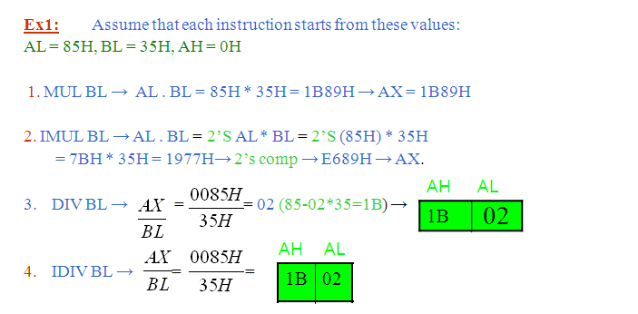


Multiplication and Division Examples
70

Slide 71
BEFORE EXECUTION
AH | 00 | AL | 05
BH | 00 | BL | 03
CH |  | CL
MUL BX
AX=lower 16 bit {000F} DX=Higher 16 bit {0000}
AFTER EXECUTION
0005*0003 = 0000 000F
AH | 00 | AL | 0F
BH |  | BL
CH |  | CL
DH | 00 | DL | 00
71

Slide 72
BEFORE EXECUTION
AH | 00 | AL | 0F
BH | 00 | BL | 02
CH |  | CL
AX=Quotient {0007}
DX=Reminder {0001}
DIV BX
000F = 7 1
AFTER EXECUTION
0002
2
AH | 00 | AL | 07
BH |  | BL
CH |  | CL
DH | 00 | DL | 01
72

Slide 73
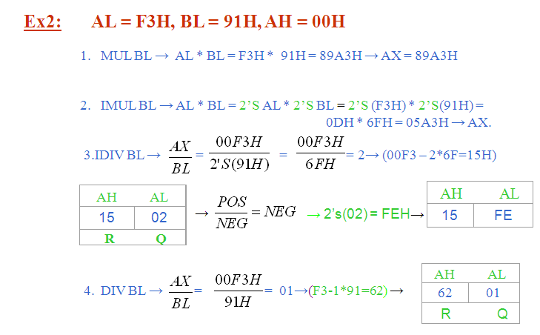
73

Slide 74
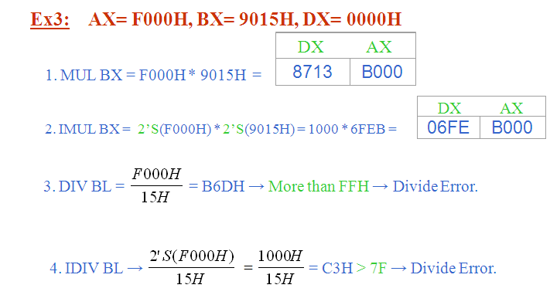
74

